Slide 1


Task Manager Web Application
A Responsive Full Stack Application
Presented by: Pragati Gupta
UID:24MCI10255
Subject: Advanced Internet Programming (AIP)

Slide 2

Purpose of the Project
To build a user-friendly task management tool.
Enable users to add, update, filter, complete, and delete tasks.
Help users stay organized and productive.

Slide 3
Importance of the Project
Encourages time management & efficiency.
Real-world utility for students & professionals.
Introduces full-stack development experience.
Aligns with industry tools like Trello, Todoist.

Slide 4
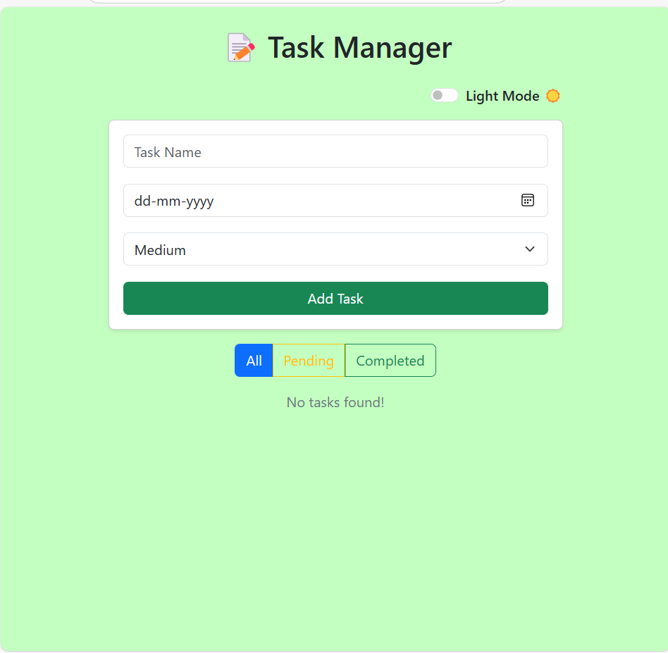
Functionalities
Add tasks with priority and due date
Edit and delete tasks
Mark as completed (toggle)
Filter by All, Completed, or Incomplete
Dark mode toggle
Animated and responsive UI

Slide 5
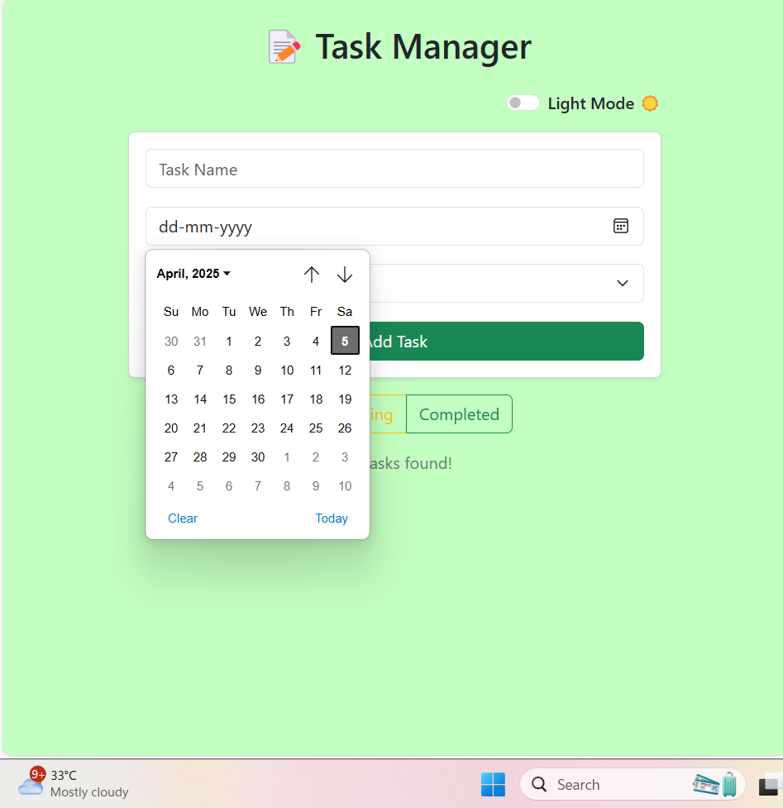
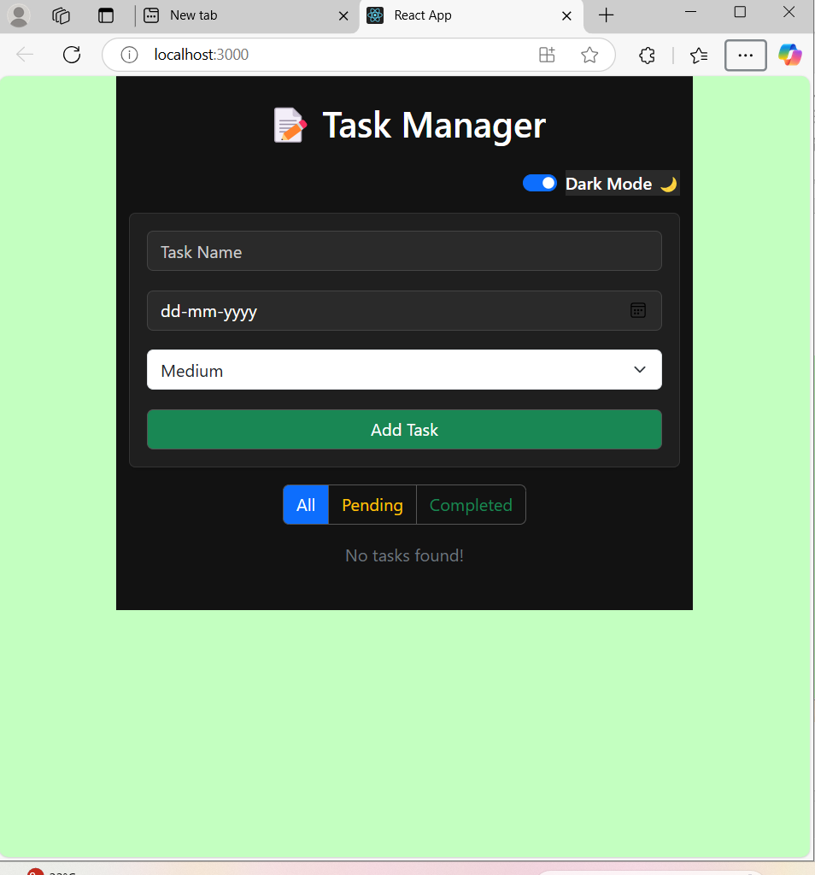
UI view

Slide 6
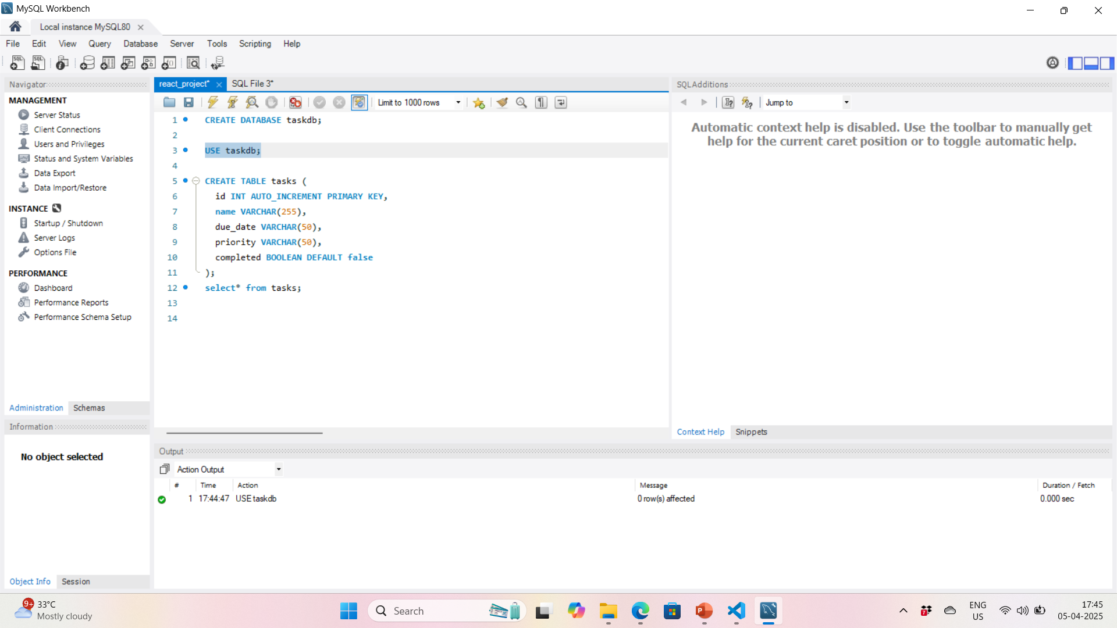
Backend Work

Slide 7
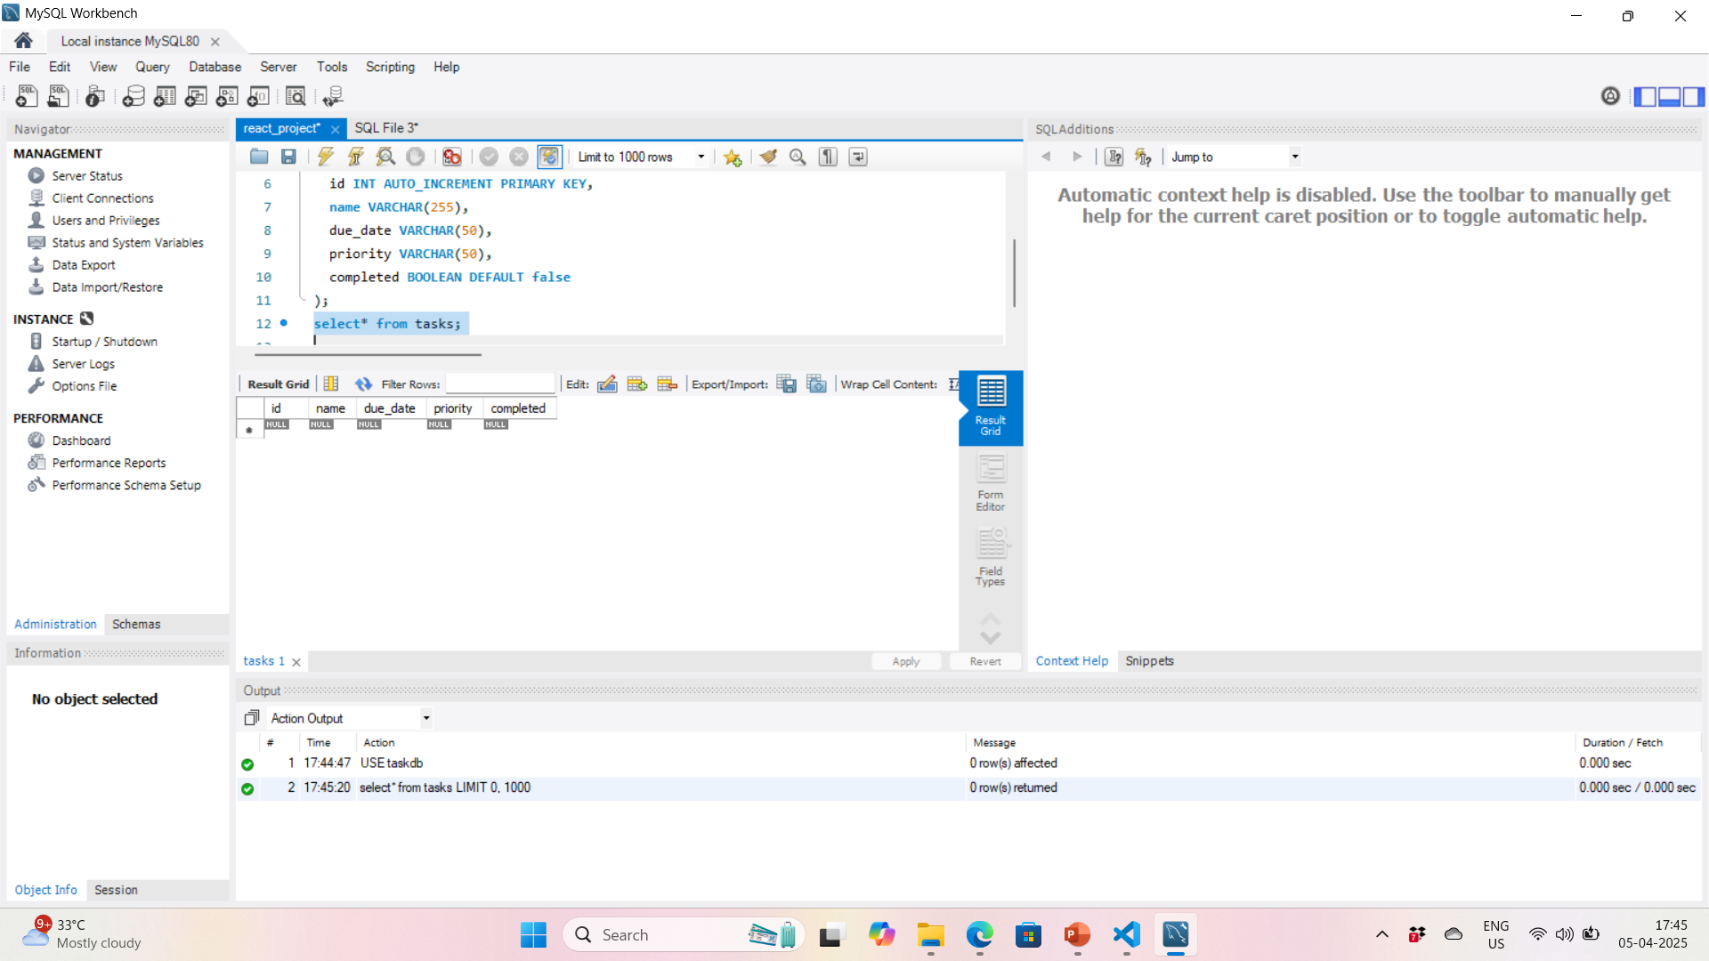

Slide 8
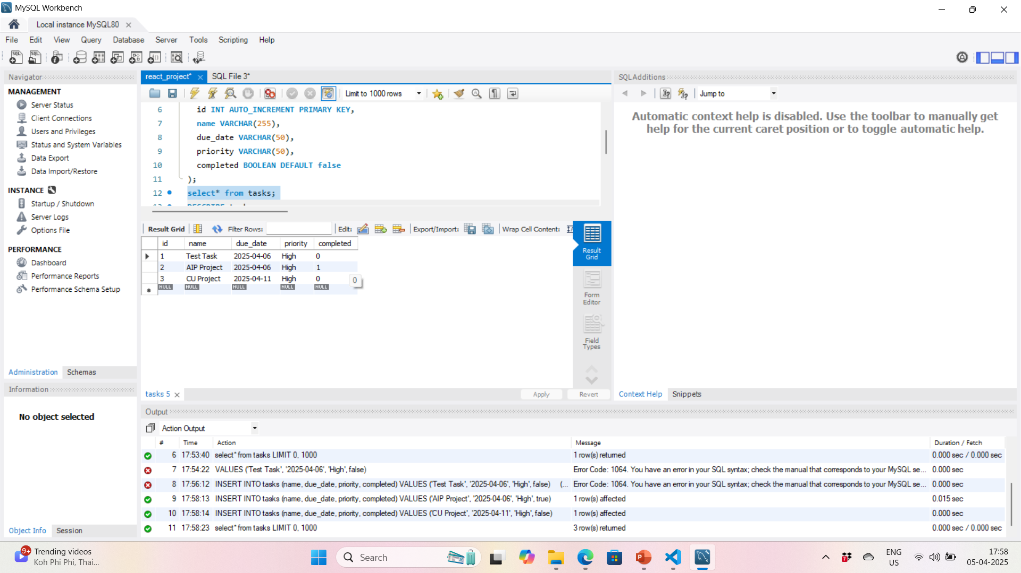

Slide 9
Technologies Used
Frontend:
ReactJS (Components, State, Hooks)
HTML, CSS, Bootstrap (UI)
Axios (API integration)
Backend:
Node.js with Express
MySQL database
Tools:
VS Code, Postman, MySQL Workbench

Slide 10
Use of AIP Topics
Servlet Alternative: Used Express.js for backend logic
JDBC Equivalent: Used mysql module in Node.js
Client-Server Architecture: Frontend and backend separation
Database Connectivity: CRUD operations with MySQL
Form Handling: React Forms for task input

Slide 11
Further Enhancements
User login and authentication
Reminder notifications via email/SMS
Drag-and-drop task ordering
Calendar integration
PWA (Progressive Web App) version

Slide 12
Learning Outcome
Learned frontend-backend integration
Understood RESTful APIs and JSON
Gained hands-on experience with MySQL
Improved UI/UX design using Bootstrap & CSS
Practiced debugging and deployment

Slide 13
Conclusion
Task Manager is a robust AIP-based project
Combines full stack technologies
Ready for real-world enhancement
A strong addition to portfolio or resume

Slide 14


